Slide 1
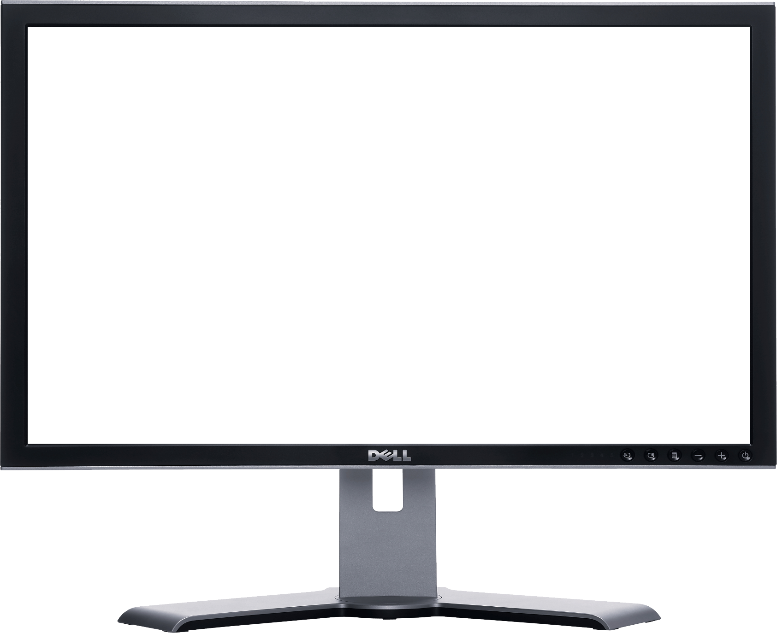

Class starts @ 11am sharp
Problem Solving & Programming
Concepts
Week 3 - Class
Please ensure your microphone is muted but working at the start of class. Video is Optional.
To test your microphone, do a test before you get started by using: https://www.onlinemictest.com/

Slide 2
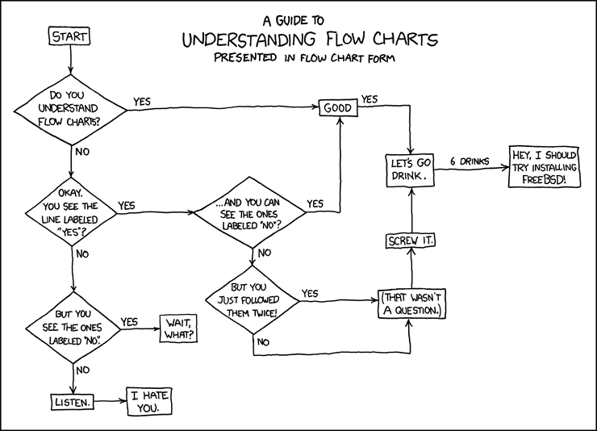
Flow Charts The Basics!
Week 3: Class
lisa.murphy@ncirl.ie

Slide 3


Attendance
Please note your attendance will be recorded throughout this class
Notes:
Make learning an adventure

Slide 4




Agenda
What is a Flow Chart?
How to create a Flow Chart?
Flow Charts Syntax and Use Case Diagram
Exercises and Activities

Slide 5

N
What is a Flow Chart?
A diagram which contains the sequence of movements or actions of people or things involved in a complex system or activity.
When to use a Flowchart?
To develop understanding of how a process is done
To study a process for improvement
To communicate to others how a process is done
When better communication is needed between people involved with the same process
To document a process
When planning a project
Who would use a Flowchart?
The uses of flowcharts are numerous in industries, such as entertainment, engineering, physical sciences, and computer programming.
Progress Bar
Flow
Charts
4 Basic
Symbols
Exercise
1
Other Flow
Chart tools
Exercise
2
Exercise
3
BREAK
Use Case
Diagram
Exercise
4
Exercise
5

Slide 6
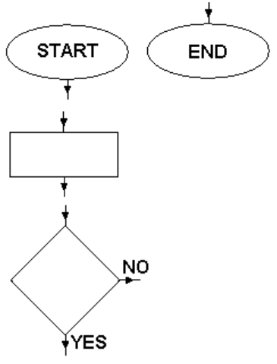
N
4 Basic Flowchart Symbols
All the flow charts we look at beginning with a Start Point and finish with an End Point.
Most of the boxes on a flow chart are Instructions, which tell you what to do next. These appear in rectangular boxes.
Sometimes a question needs to be answered to decide what instruction should happen next. These questions are put in Decision Boxes.
Progress Bar
✓
Flow
Charts
4 Basic
Symbols
Exercise
1
Other Flow
Chart tools
Exercise
2
Exercise
3
BREAK
Use Case
Diagram
Exercise
4
Exercise
5

Slide 7
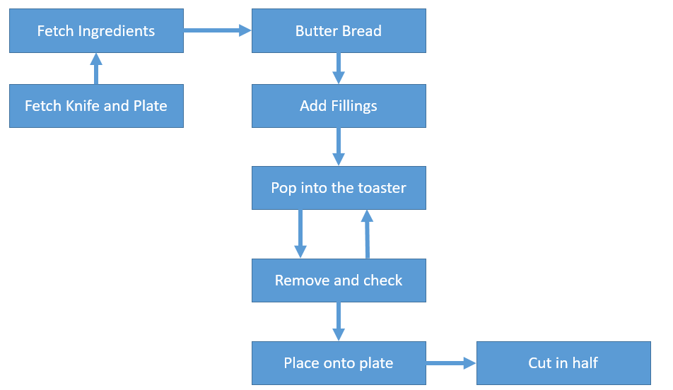
N
Lets look at an example
The steps to making a toasted sandwich:
Fetch Ingredients
Fetch knife
Fetch plate
Butter Bread
Add Fillings
Place in toaster
Remove from toaster and check if toasted
Repeat steps 6 & 7 as needed
Place on plate
Cut in half
How this example would look in a Flowchart
INPUT
PROCESS
OUTPUT
Progress Bar
✓
✓
Flow
Charts
4 Basic
Symbols
Exercise
1
Other Flow
Chart tools
Exercise
2
Exercise
3
BREAK
Use Case
Diagram
Exercise
4
Exercise
5

Slide 8

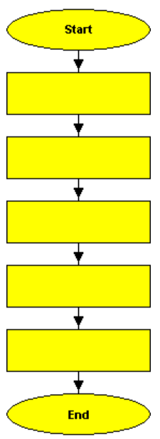
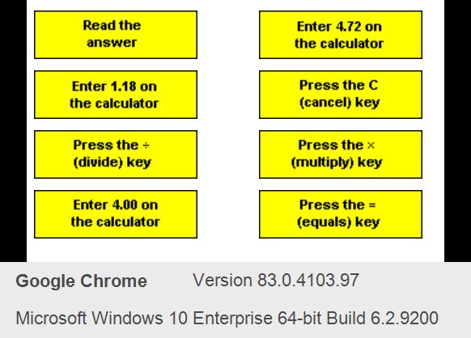

E
xercise 1: Create a Flowchart
5 mins
E
INSTRUCTIONS
The flow chart on the right is meant to show the steps for working out 4.72 divided by 1.18 on a calculator.
Place the instructions on the left in the flow chart by redrawing the Flowchart in your Teams notebook. Some of the instructions are not required - you should only include those which are relevant to the task.
Teams
Notebook

Slide 9
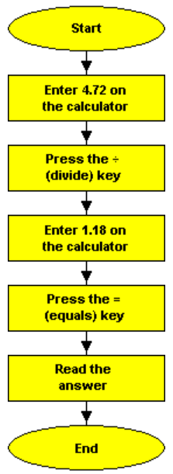
E
xercise 1: Answer
5 mins
E
Progress Bar
✓
✓
✓
Flow
Charts
4 Basic
Symbols
Exercise
1
Other Flow
Chart tools
Exercise
2
Exercise
3
BREAK
Use Case
Diagram
Exercise
4
Exercise
5

Slide 10

N
Other Flowchart Tools
A flowchart always starts at the top of the page and flows down. If you need more than one page, start another column on the same page or go on to another page.
If there is something you need to remember, you can write a note beside a block. This makes the flowchart an annotated block.
Flow lines are used to connect blocks by exiting from one and entering another
The parallelogram indicates input to and output from the computer memory. An I/O block has one entrance and one exit only
The Ellipse Indicates a loop. For example, do you want to play the game again?

Slide 11
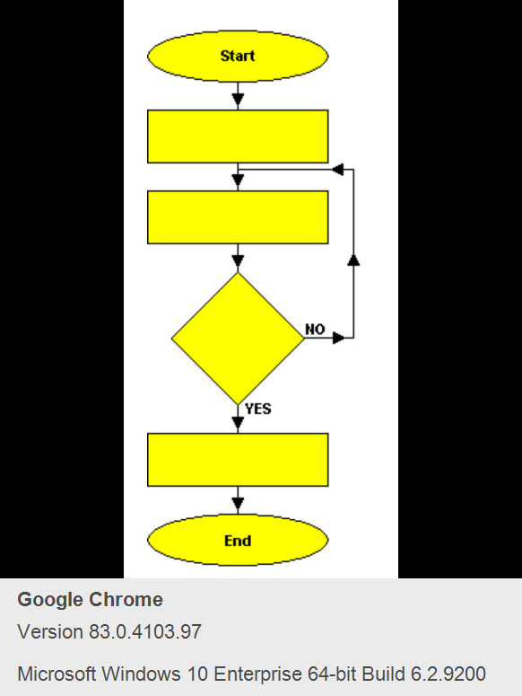
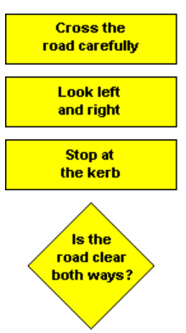
E
xercise 2:Crossing the Road
5 mins
E
INSTRUCTIONS
The flow chart on the right is meant to show the steps for safely crossing the road. There is a decision box in this flow chart. Place the instructions on the left in the flow chart by redrawing the Flowchart in your Teams notebook.
Teams
Notebook
Progress Bar
✓
✓
✓
✓
Flow
Charts
4 Basic
Symbols
Exercise
1
Other Flow
Chart tools
Exercise
2
Exercise
3
BREAK
Use Case
Diagram
Exercise
4
Exercise
5

Slide 12
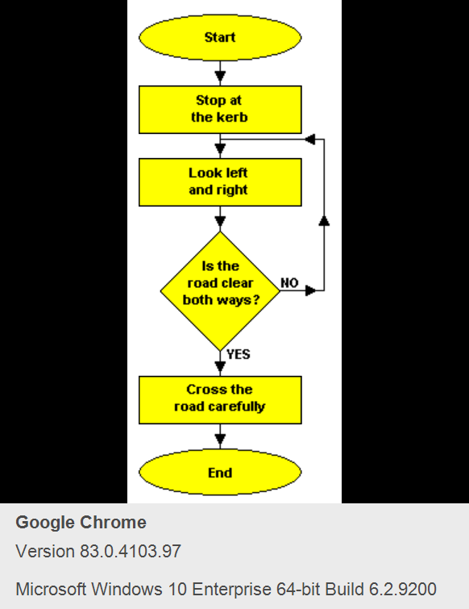
E
xercise 2: Answer
5 mins
E
✓
✓
✓
✓
✓
Flow
Charts
4 Basic
Symbols
Exercise
1
Other Flow
Chart tools
Exercise
2
Exercise
3
BREAK
Use Case
Diagram
Exercise
4
Exercise
5

Slide 13
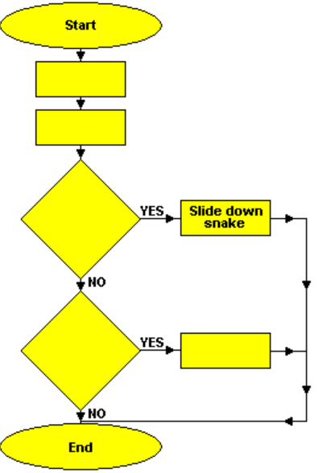
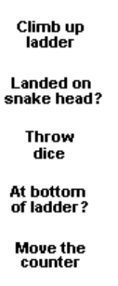
E
xercise 3: Snakes and Ladders
5 mins
E
INSTRUCTIONS
The flow chart on the right is meant to show the steps for making a move in a 'Snakes and Ladders' game. Place the instructions on the left in the flow chart by redrawing the Flowchart in your Teams notebook.
Teams
Notebook

Slide 14
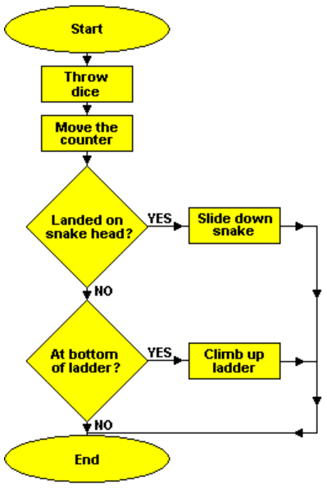
E
xercise 3: Answer
5 mins
E
Progress Bar
✓
✓
✓
✓
✓
✓
Flow
Charts
4 Basic
Symbols
Exercise
1
Other Flow
Chart tools
Exercise
2
Exercise
3
BREAK
Use Case
Diagram
Exercise
4
Exercise
5

Slide 15

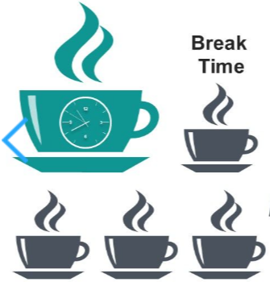
T
Check Chat window for return time
TEA BREAK FOR 10 MINUTES

Slide 16
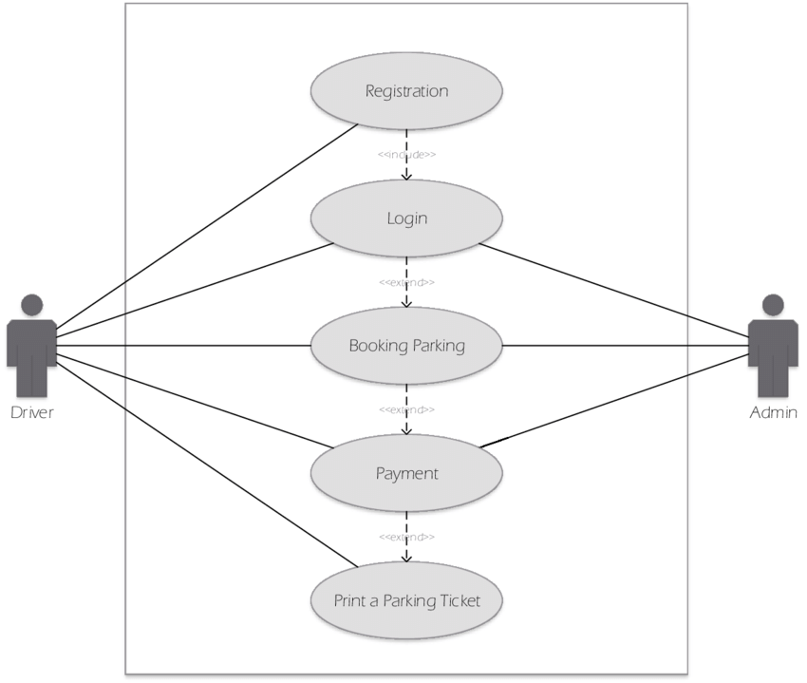
N
Flowchart Vs Use Case Diagram
Use Cases are related to the interactions between people and systems.
A process flowchart is a graphical representation of how a business object like an order will flow through various business rules and system states.
For a really complicated problem, you would use flowcharts first, then use case diagram.

Slide 17
N
Use Case Diagram
Use Case Diagram of Car Parking Information System
An actor in use case modeling specifies a role played by a user or any other system that interacts with the subject.
"Include" is used to extend the base use case and it is a must condition i.e. included use case run must run successfully to complete base use.
"Exclude" on the other hand is optional use case which extends the base use case, base use case can run successfully even without invoking/calling the extending use case.
Includes/Extends
Actor
A system boundary is a rectangle that you can draw in a use-case diagram to separate the use cases that are internal to a system from the actors that are external to the system
Actor
System Boundary

Slide 18
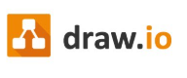

E
xercise 4: Logging into Facebook
20 mins
E
Log into draw.io to create your flowchart.
Create new diagram and from template, select Basic, and Flowchart to get you started.
Save file as FacebookDiagram.io
TASK:
Draw a flowchart to log into a Facebook account
This problem can be solved in many ways, so I encourage you to think and draw a flowchart for this problem using your imagination.
Progress Bar
✓
✓
✓
✓
✓
✓
✓
✓
Flow
Charts
4 Basic
Symbols
Exercise
1
Other Flow
Chart tools
Exercise
2
Exercise
3
BREAK
Use Case
Diagram
Exercise
4
Exercise
5

Slide 19
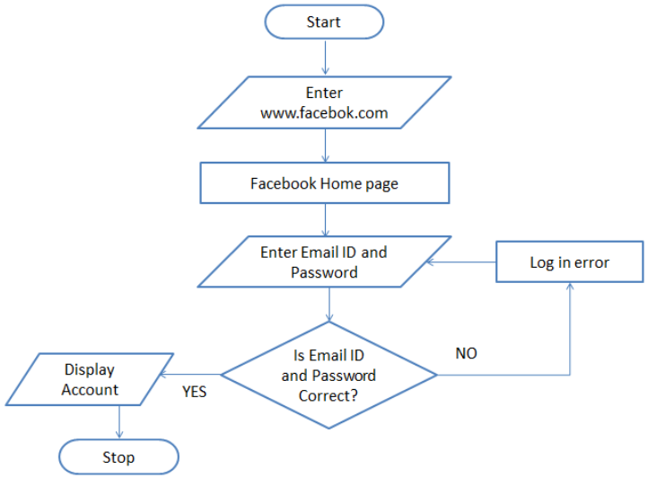
E
xercise 4: Answer
20 mins
E
To log into Facebook, we first enter the Facebook URL www.facebook.com into our browser. This request is sent to the Facebook server and it responds by sending us the home page of Facebook.
Next, we enter our registered Email ID and Password and click the Login button.
Then our login credential is checked. If it is correct, we are show our profile. On the other hand, if the login credential is wrong, then an error occurs and we are prompted to re-enter our Email ID and Password.
Progress Bar
✓
✓
✓
✓
✓
✓
✓
✓
✓
Flow
Charts
4 Basic
Symbols
Exercise
1
Other Flow
Chart tools
Exercise
2
Exercise
3
BREAK
Use Case
Diagram
Exercise
4
Exercise
5

Slide 20
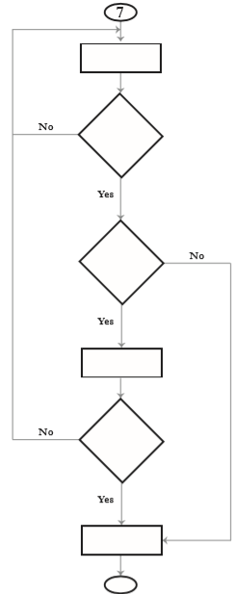
E
xercise 5: School Admission
10 mins
E
INSTRUCTIONS
The following empty flowchart gives the steps to be followed while seeking admission to a new school. The phrases to be filled in the boxes are also given.
Complete the flowchart by filling in the number of the corresponding phrase, inside each box. For example: the number corresponding to the first box in the flowchart is 7.
Place the instructions on the left in the flow chart by redrawing the Flowchart in your Teams notebook.
Search for a school
Prepare for the admission test and write the test
Did you pass the exam?
Submit necessary documents and get admission
End
Are the seats available?
Start
Is there an admission test?

Slide 21
What your Flowchart should include?
START
START and END action (using a rounded rectangle)
Rectangle for actions and a parallelogram for input or output tasks. For example an input where a user answers a question and an output when the scores are presented back to the user
Consider using a loop for asking the user to play the game again.
Where a decision has to be made, use the diamond shape for this i.e. Did the user get the question right? True or False
Ask question to user
User answers question
User guess question correctly?
Minus 1 point
No
END
Award 1 point

Slide 22
Attendance
Attendance will now be downloaded
Notes:
Make learning an adventure

Slide 23
Lets Recap
Flow Chart
A diagram which contains the sequence of movements or actions of people or things involved in a complex system or activity.
4 Basic
Shapes
A flowchart always starts at the top of the page and flows down.
Progress Bar
✓
✓
✓
✓
✓
✓
✓
✓
✓
✓
Flow
Charts
4 Basic
Symbols
Exercise
1
Other Flow
Chart tools
Exercise
2
Exercise
3
BREAK
Use Case
Diagram
Exercise
4
Exercise
5

